Slide 1
2.1 Data Management Plans & Profiles
Introduction to Data Management Concepts and Practices
Helen Tibbo
tibbo@email.unc.edu
September 8, 2016

Slide 2
PART I: Data Management Plans

Slide 3
Data Management Plans
Funding bodies are increasingly asking for DMPs
Are also useful for general data management, not just grant applications
Indicates what type of data is collected/created/used and how
Discusses restrictions on the data
In general, helps to manage the data better during collection, use, and disposition.
Many DMP tools being developed.

Slide 4
NSF & Data Management Plans
“Beginning January 18, 2011, proposals submitted to NSF must include a supplementary document of no more than two pages labeled "Data Management Plan" (DMP). This supplementary document should describe how the proposal will conform to NSF policy on the dissemination and sharing of research results. Proposals that do not include a DMP will not be able to be submitted. For more information about this new requirement, please see the Grant Proposal Guide, Chapter II.C.2.j and the Data Management and Sharing Frequently Asked Questions(FAQs).”
http://www.nsf.gov/eng/general/dmp.jsp

Slide 5
Many Tools Developed
Most of these come from libraries or projects with library partners.
Academic Libraries offer many useful tools, advice, and consultation
MIT
UNC
Stanford
DMP Tool from DataOne
DMPOnline DCC’s web-based tool
DCC’s Checklist for a Data Management Plan
Data Archives such as ICPSR also offer extensive guidance

Slide 6
Funder Requirements - DOD
The U.S. Department of Defense (DOD) has released draft of the DOD Public Access Plan, which requires that all proposals for research funding include a data management plan outlining how data underlying publications will be managed and shared. In addition, the DOD will require deposit of metadata for each data set to a new data catalog at the Defense Technical Information Center (DTIC).

Slide 7
Funder Requirements - NASA
The U.S. National Aeronautics and Space Administration (NASA) requires that all proposals for research funding include a data management plan that outlines how data underlying publications will be managed and shared.

Slide 8
Funder Requirements - DOE
The U.S. Department of Energy requires that all proposals for research funding submitted to the Office of Science include a Data Management Plan.

Slide 9
Funder Requirements - NIH
National Institutes of Health: Data Sharing Policy: Supports the sharing of research data and expects researchers funded at $500,000 or more to include a data sharing plan in their grant proposals. For research in genomics, see the NIH Genomics Data Sharing Policy.

Slide 10
Funder Requirements – NEH & IMLS
The National Endowment for the Humanities (NEH) Office of Digital Humanities requires data management plans as a part of grant applications for proposals and awards.
The Institute of Museum and Library Services (IMLS) also requires a data management plan for grant applications.

Slide 11
Library Services for DMPs

Slide 12
MIT: Why Manage & Share Your Data?
Increase your research impact
Save time
Preserve your data
Maintain data integrity
Meet grant requirements
Promote new discoveries
Support open access

Slide 13
MIT: Write a DMP -1
Project, experiment, and data description
What’s the purpose of the research?
What is the data? How and in what format will the data be collected? Is it numerical data, image data, text sequences, or modeling data?
How much data will be generated for this research?
How long will the data be collected and how often will it change?
Are you using data that someone else produced? If so, where is it from?
Who is responsible for managing the data? Who will ensure that the data management plan is carried out?
http://libraries.mit.edu/data-management/plan/write/

Slide 14
MIT: Write a DMP - 2
Documentation, organization, and storage
What documentation will you be creating in order to make the data understandable by other researchers?
Are you using metadata that is standard to your field? How will the metadata be managed and stored?
What file formats will be used? Do these formats conform to an open standard and/or are they proprietary?
Are you using a file format that is standard to your field? If not, how will you document the alternative you are using?
What directory and file naming convention will be used?
What are your local storage and backup procedures? Will this data require secure storage?
What tools or software are required to read or view the data?

Slide 15
MIT: Write a DMP - 3
Access, sharing, and use
Who has the right to manage this data? Is it the responsibility of the PI, student, lab, MIT, or funding agency?
What data will be shared, when, and how?
Does sharing the data raise privacy, ethical, or confidentiality concerns? Do you have a plan to protect or anonymize data, if needed?
Who holds intellectual property rights for the data and other information created by the project? Will any copyrighted or licensed material be used? Do you have permission to use/disseminate this material?

Slide 16
MIT: Write a DMP - 4
Access, sharing, and use
Are there any patent- or technology-licensing-related restrictions on data sharing associated with this grant?
Will this research be published in a journal that requires the underlying data to accompany articles?
Will there be any embargoes on the data?
Will you permit re-use, redistribution, or the creation of new tools, services, data sets, or products (derivatives)? Will commercial use be allowed?

Slide 17
MIT – Write a DMP – 5
Archiving
How will you be archiving the data? Will you be storing it in an archive or repository for long-term access? If not, how will you preserve access to the data?
Is a discipline-specific repository available? If not, you could consider depositing your data into DSpace@MIT.
How will you prepare data for preservation or data sharing? Will the data need to be anonymized or converted to more stable file formats?
Are software or tools needed to use the data? Will these be archived?
How long should the data be retained? 3-5 years, 10 year, or forever?

Slide 18
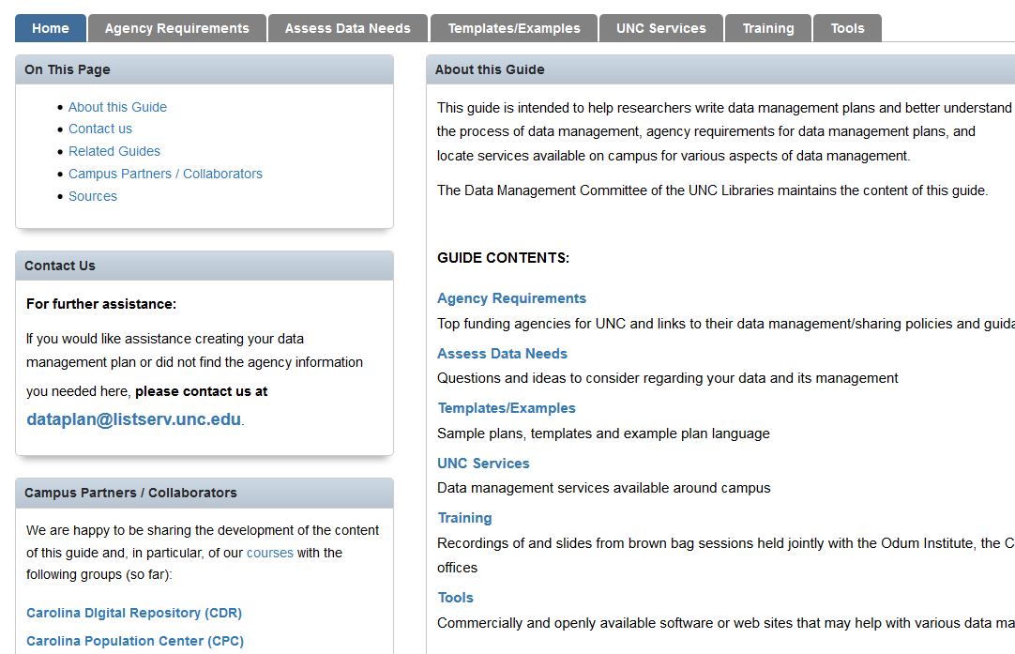
UNC’s Research Data Toolkit

Slide 19
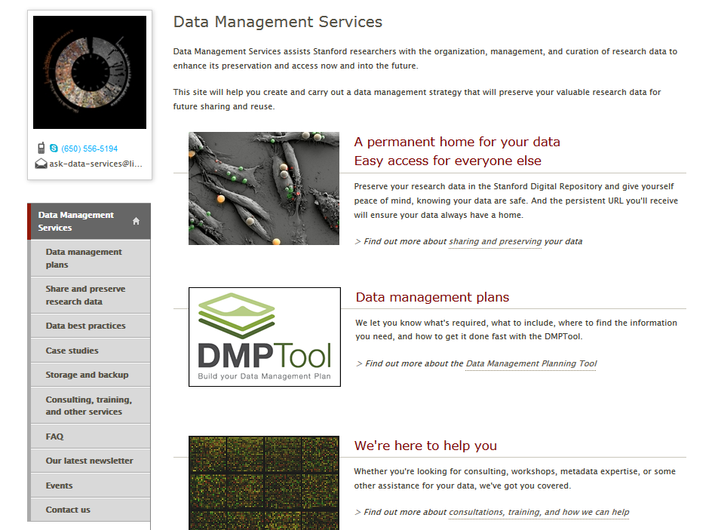
Stanford Univ. Library

Slide 20
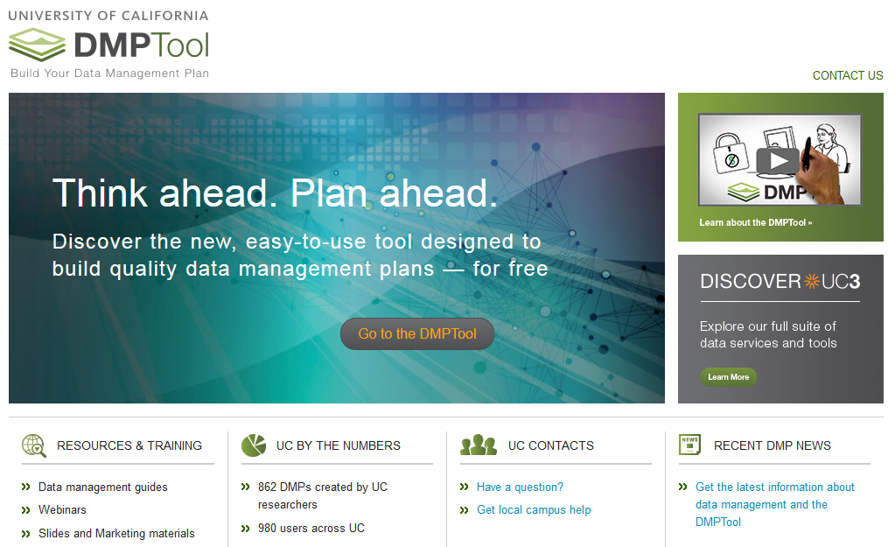
https://dmptool.org/

Slide 21
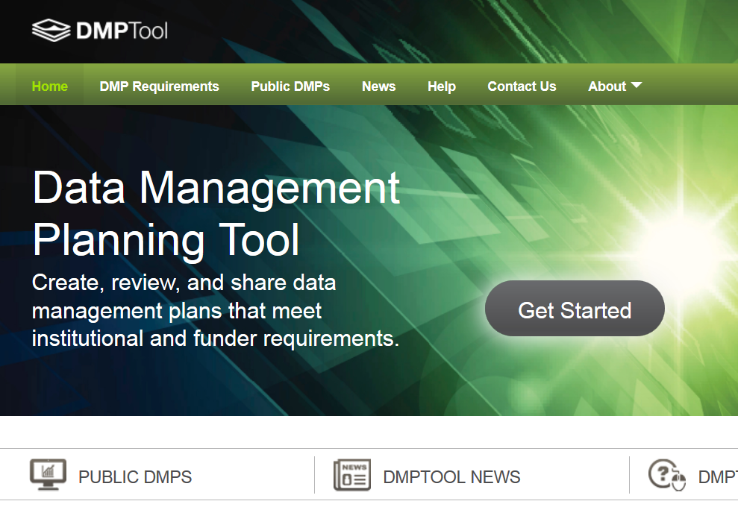

Slide 22
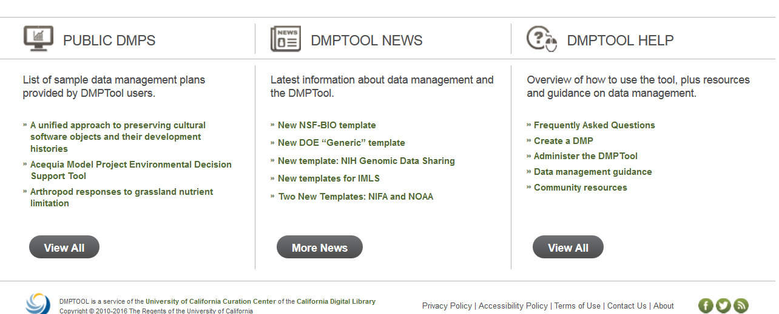
DMPTool Resources
https://dmptool.org/

Slide 23
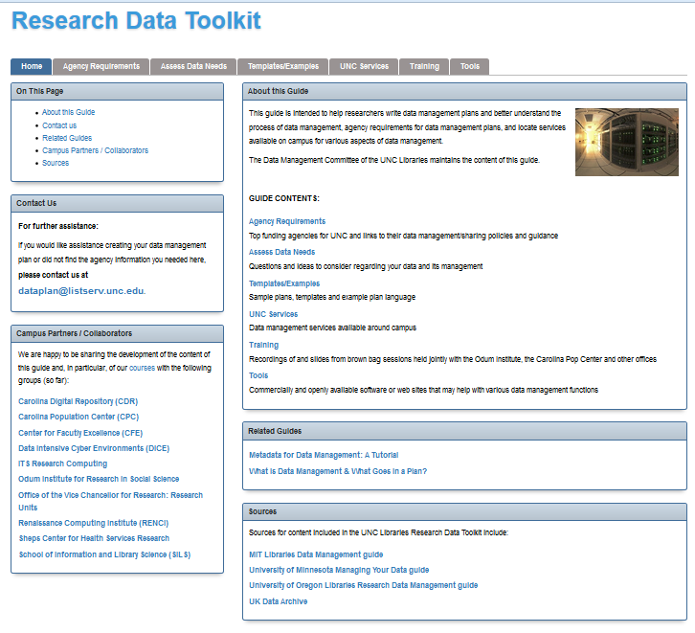
http://guides.lib.unc.edu/researchdatatoolkit

Slide 24
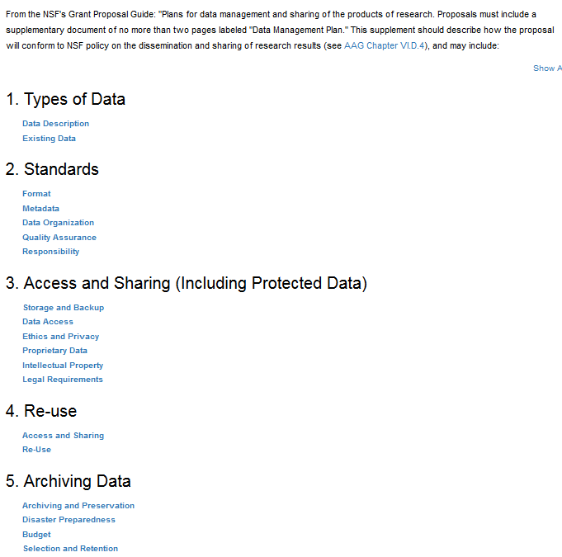
http://guides.lib.unc.edu/c.php?g=8535&p=43809

Slide 25
Other Guides to Data Management
CIESIN: Geospatial Electronic Records: Resources on managing and preserving geospatial data and related electronic records.
Digital Curation Centre (DCC): Includes resources, events, and training opportunities.
Oak Ridge National Laboratory: Data Management for Data Providers: Offers practical methods to successfully share and archive data.
UK Data Archive: Create & Manage Data: Provides best practice strategies and methods for creating, preparing, and storing shareable datasets. See also Managing and Sharing Data: A Best Practice Guide for Researchers [pdf].

Slide 26
Exercise 1: DMPs
Break into small groups and generate a list of what you consider to be the most important elements for a DMP for your unit(s).

Slide 27
Part II: Data Curation Profiles

Slide 28
What Are Data Curation Profiles
“A Data Curation Profile is essentially an outline of the ‘story’ of a data set or collection, describing its origin and lifecycle within a research project.”
“The Profile and its associated Toolkit grew out of an inquiry into the changing environment of scholarly communication, especially the possibility of researchers providing access to data much further upstream than previously imagined.”
The DCP project explored the roles of researchers and librarians in data sharing.
http://datacurationprofiles.org/

Slide 29
History of the Data Curation Profiles Project
Few tools existed to train librarians in data curation in 2006 so Purdue University Libraries and the Graduate School of Library and Information Science at the Univ. of Illinois Urbana-Champaign created the Data Curation Profile project.
Funded by the Institute for Museum and Library Services (IMLS).
Project ran from 2007-2010 and Purdue Univ. is still building on this with subsequent grants and projects.

Slide 30
Project Description
To identify the needs of researchers with regard to their data, project personnel conducted interviews, surveys and observations of the researchers. The interviews were used to gather information about the scientific workflow of each researcher and their range of research outputs (e.g., raw data through published forms), as well as to identify their needs or discovery, access, usage and re-use of data. Disciplines covered in the study included:
Agronomy & Soil Science
Anthropology
Biochemistry
Biology
Civil Engineering
Earth & Atmospheric Sciences
Electrical & Computer Engineering
Food Science
Geology
Horticulture & Plant Science
Kinesiology
Speech & Hearing

Slide 31
Why Data Curation Profiles
To provide a guide for discussing data with researchers
To give insight into areas of attention in data management
To help assess information needs related to data collections
To give insight into differences between data in various disciplines
To help identify possible data services
To create a starting point for curating a data set for archiving and preservation

Slide 32
Purpose and Use of the Profiles
“Data Curation Profiles are designed to capture requirements for specific data generated by researchers as articulated by the researchers themselves.”
“They are also intended to enable librarians and others to make informed decisions in working with data of this form, from this research area or sub-discipline.”
Data Curation Profiles employ a standardized set of fields to enable comparison.
From the DCP website

Slide 33
Uses for Data Curation Profiles – Individuals
At an individual level, the Data Curation Profile:
provides a structure for conducting a data interview between an information professional and a researcher or research group
provides a means for a researcher or a research group to thoughtfully consider their needs for the data beyond its immediate use

Slide 34
Uses for Data Curation Profiles - Institutions
At an institutional level, the Data Curation Profile:
can serve as a foundational document to guide the management and/or curation of a particular data set
can be shared with staff providing data services and others to inform them of the researcher's needs and ensure that everyone is on the same page
may be used to inform the development of data services to be offered by the institution, as well as to help identify the types of tools, infrastructure and responsibilities for data services staff

Slide 35
Award Winning Data Curation Profiles Toolkit
The DCP Toolkit won the Association of College and Research Libraries Science and Technology Section’s 2013 Innovation Award – April 2013.

Slide 36
Video of the DCP Symposium
Please browse through the videos at: http://docs.lib.purdue.edu/dcpsymposium/

Slide 37
Exercise 2: Data Curation Profiles
Break into groups and discuss how your unit or agency could use Data Curation Profiles to better manage your data.
Suggest alterations to the DCP template for your data.
Each group will report out in approximately 15 minutes.

Slide 38
Part III: Digital Preservation Planning

Slide 39
Digital Preservation Planning
Digital Preservation Planning revolves around the development of various policies and strategies.
Management is achieved through the use of nested policies.

Slide 40
Relationship of Policy Elements
A repository is assumed to have an overall Repository Mission Statement, part of which will be concerned with preservation.
The Preservation Strategic Plan states how the mission will be achieved, in general terms with goals and objectives.
The Preservation Policy then declares the range of approaches that the repository will employ to ensure preservation (that is, to implement the Preservation Strategic Plan), and
The Preservation Implementation Plan translates those into services that the repository must carry out.

Slide 41
Planning/Policy/Action Hierarchy
Preservation Strategic Plan
A written statement, authorized by the management of the repository, that states the goals and objectives for achieving that part of the mission of the repository concerned with preservation. Preservation Strategic Plans may include long-term and short-term plans.
Preservation Policy
Written statement, authorized by the repository management, that describes the approach to be taken by the repository for the preservation of objects accessioned into the repository. The Preservation Policy is consistent with the Preservation Strategic Plan.
Notes:
In general the term policy is not well defined in the literature and even less in the practice. A basic definition is provided by ISO standards (even if not consistently): for instance in the standard ISO 30300, Information and documentation — Management systems for records — Fundamentals and vocabulary the term ‘records policy’ is defined as following: “overall intentions and direction of an organization related to management systems for records formally expressed by top management”. The formal nature of the policy – no matter the specific domain where applied – is always recognized as an essential requirement. According to Gartner website the term policy is intended as “an accountability framework to encourage desirable behavior in the evaluation, creation, storage, use, archival and deletion of information” which includes “the processes, roles, standards and metrics that ensure the effective and efficient use of information in enabling an organization to achieve its goals”
The preservation policies have the same ambiguous nature and have been differently interpreted by the repositories in various domains (see the APARSEN deliverable 35 dedicated to this specific issue: D35.1 Exemplar good governance structures and data policies) (www.alliancepermanentaccess.org/index.php/aparsen/aparsen-research/wp35-data-policies-and-governance).
It is very important to verify in the repository who is responsible for what and how: it is necessary to transform the abstract model into (good) practice.

Slide 42
Planning/Policy/Action Hierarchy
Preservation Implementation Plan
A written statement, authorized by the management of the repository that describes the services to be offered by the repository for preserving objects accessioned into the repository in accordance with the Preservation Policy.
Machine-Readable Rules:
Translation of human policies into actionable computer tasks.

Slide 43
Planning/Policy/Action Hierarchy
Use of Standards
Awareness and selection of appropriate standards for the repository.
Best Practices
Awareness and selection of appropriate best practices, workflows, tasks, and other activities.

Slide 44
Policy Continuum
Organizational
High-level organizational policies
Reflects the intentions of the organization
Lower-level organizational policies
Document the decisions of the organization
Individual policy statements
Regulate the actions of the organization
Encoded policy statement
From Dig. Pres. Mang. Workshop
Technological

Slide 45
Planning Strategies
Develop an internal mandate
Determine measurable objectives
Establish specific timeframes
Build a team of players with:
Differing viewpoints
Common Goals
Shared Commitments
Understand your restraints
Maximize your opportunities

Slide 46
Repository Core Criteria
An Intellectual Context for Institutional Repositories from Center for Research Libraries (https://www.crl.edu/archiving-preservation/digital-archives/metrics-assessing-and-certifying/core-re)
Has a Commitment to Digital Object Maintenance
Demonstrates Organizational Fitness
Maintains Legal & Regulatory Legitimacy
Maintains Effective & Efficient Policies
Establishes Acquisition & Ingest Criteria
Maintains Content Integrity, Authenticity & Usability
Maintains Audit Trails & Metadata
Fulfills Dissemination Requirements
Has a Strategic Program for Preservation Planning & Action
Maintains an Adequate Technical Infrastructure

Slide 47
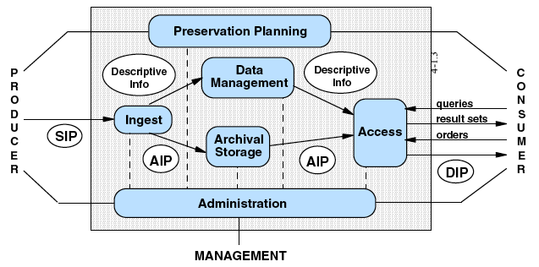
OAIS Reference Model

Slide 48
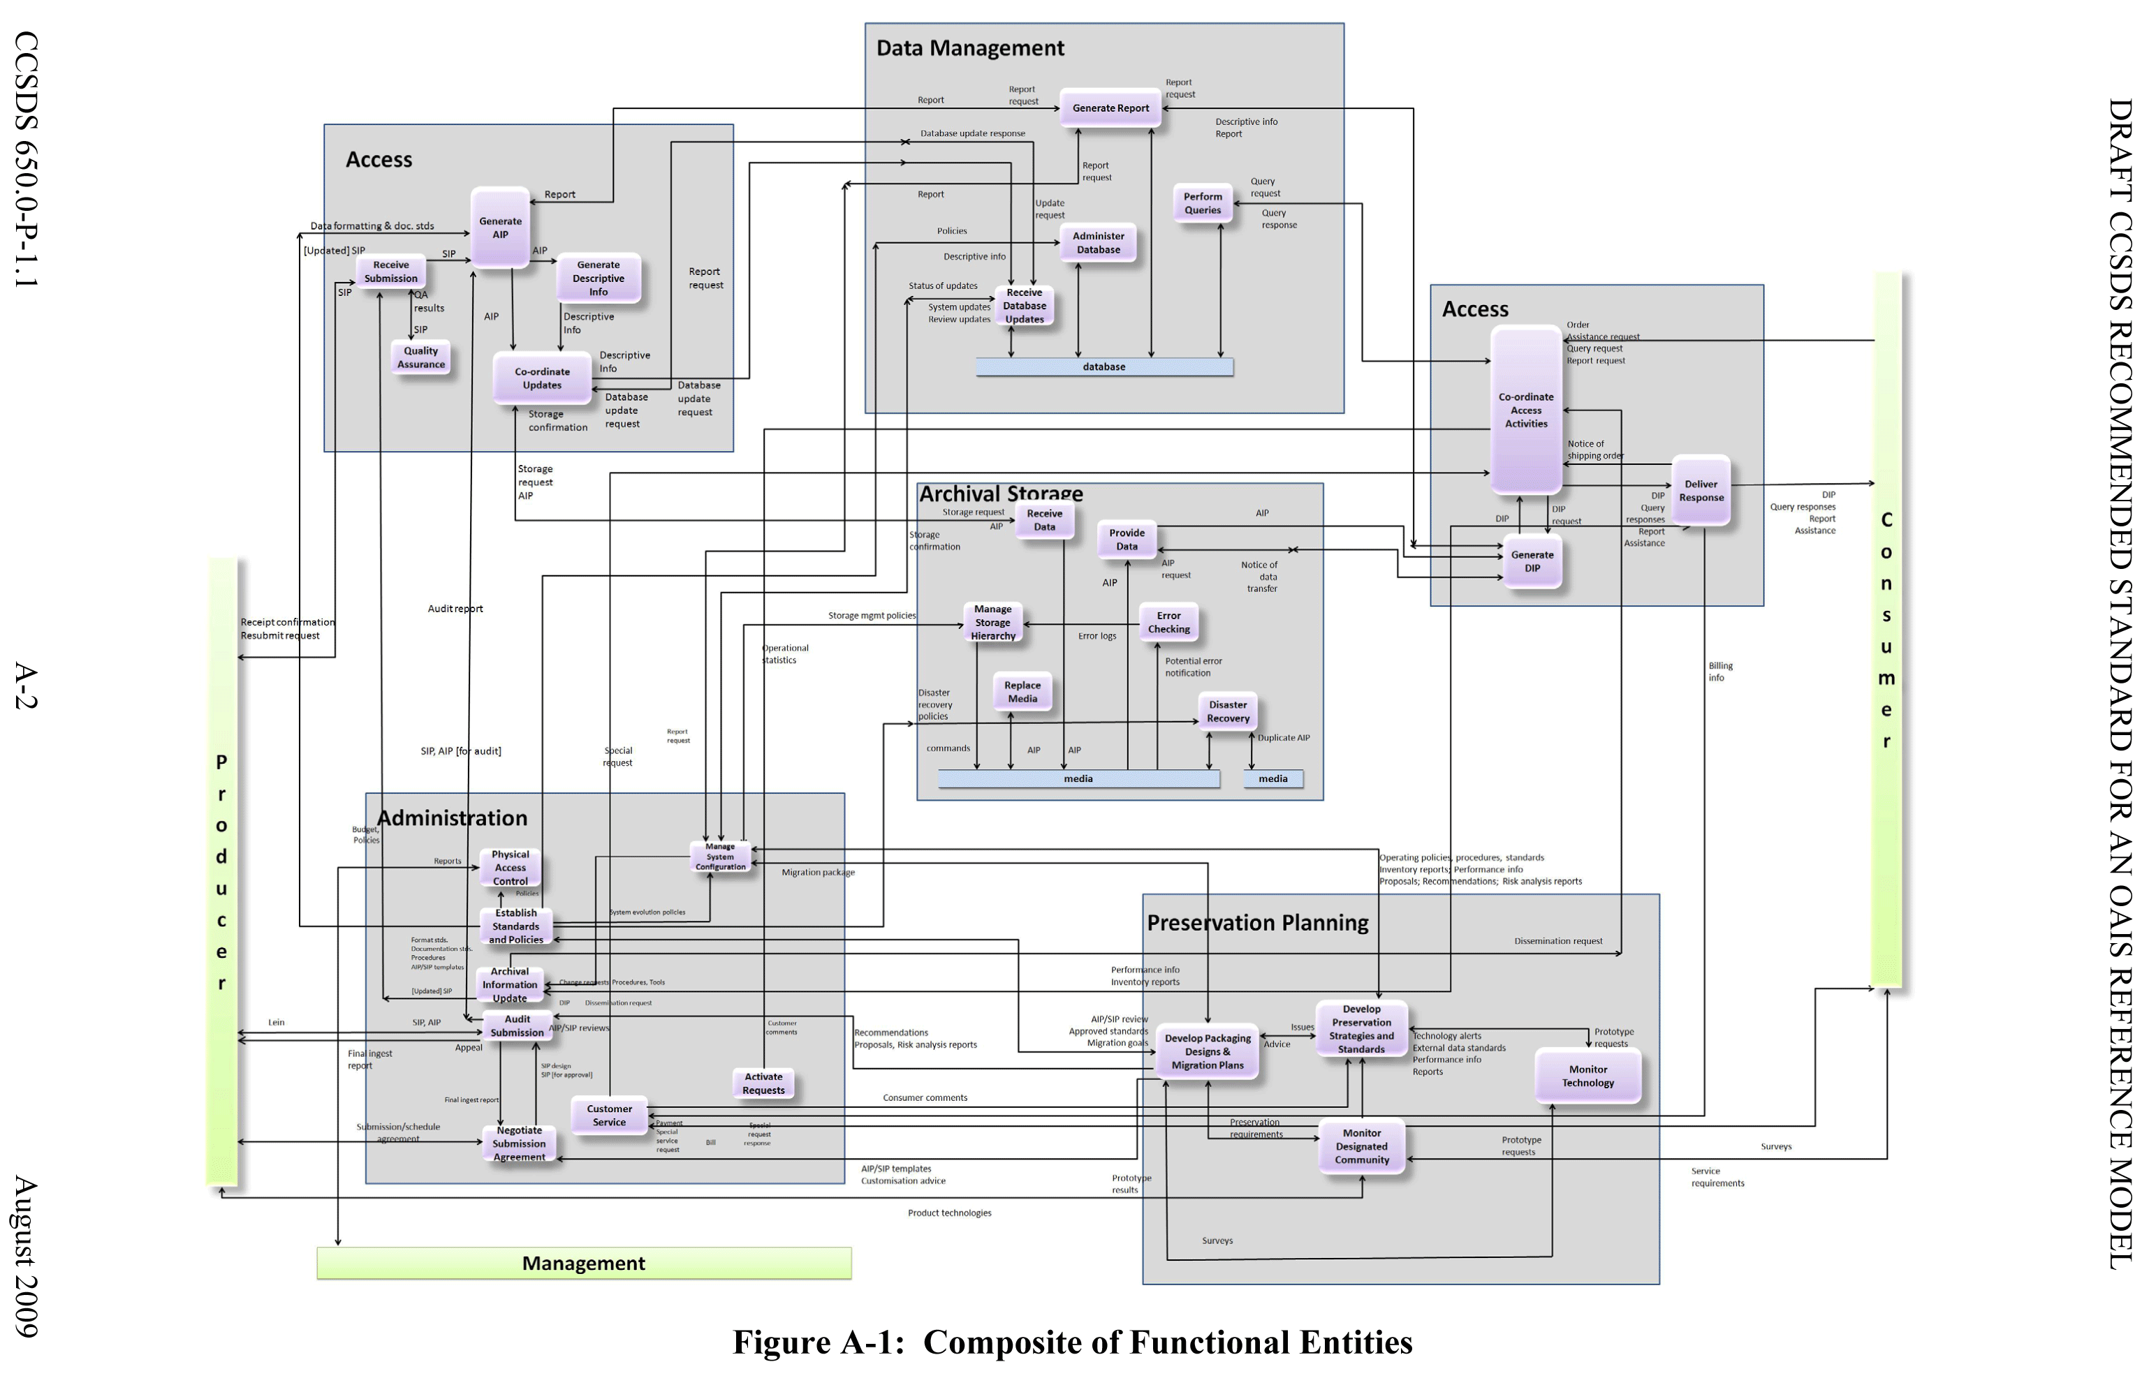
Expanded OAIS Model
OAIS REFERENCE MODEL

Slide 49
Preservation Planning
OAIS REFERENCE MODEL

Slide 50
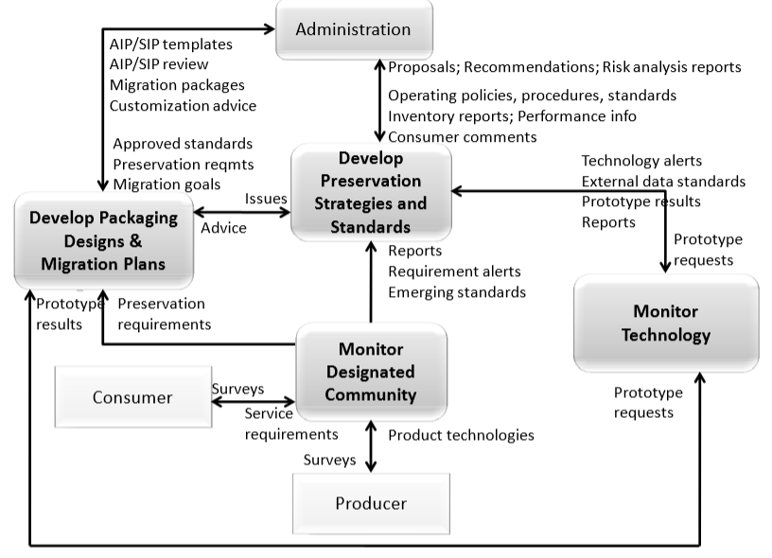
OAIS Preservation Planning

Slide 51
Attributes of a TDR (Captured in Pt.3 of ISO 16363)
All policy & planning needs to reflect attributes of trustworthy digital repositories:
OAIS Compliance
Administrative Responsibility
Organizational Viability
Financial Sustainability
Technological and Procedural Suitability
System Security
Procedural Accountability

Slide 52


The Three-legged Stool for a Digital Curation Program
Organizational Infrastructure
Technological Infrastructure
Resources Framework
$$$$
Adapted from: Kenney and McGovern, 2003

Slide 53
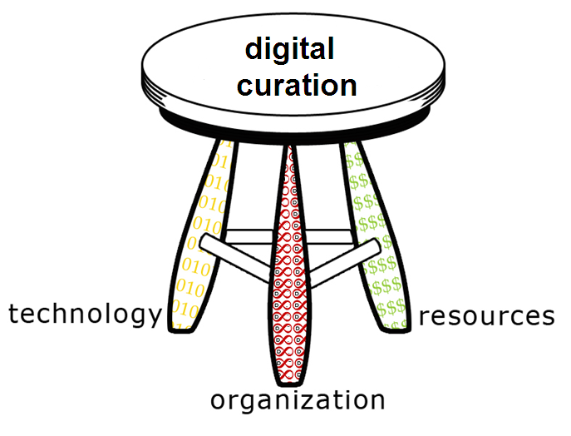
DPM Workshop’s Three-legged Stool
(how?)
(how much?)
(how?)
(how much?)
(what?)
(what?)
Adapted from: Kenney and McGovern, 2003

Slide 54
Organizational Infrastructure
Best framework: ISO 16363
Best reflected in:
mission
policy development and implementation
long-term planning
institutional commitment
participation by Producers and Consumers
Adapted from: Kenney and McGovern, 2003

Slide 55
Technological Infrastructure
Most comprehensive framework: OAIS
Combination of:
hardware and software
packaging and re-packaging
network, security, and services
functions and workflow
procedures, protocols, documentation
technical and curation skills
Adapted from: Kenney and McGovern, 2003

Slide 56
Resources Framework
No community-based articulation comparable to 16363 or OAIS – yet…
Includes:
staff, training, and development
technology and related developments
outreach and designated community support
other
$$$$
Adapted from: Kenney and McGovern, 2003

Slide 57
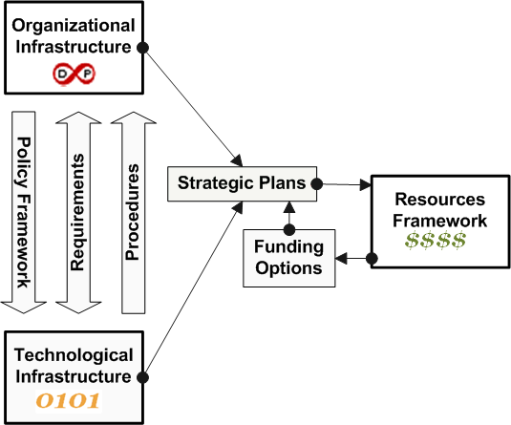
Connecting the 3 Legs
Source: McGovern, 2005

Slide 58
Key to Policy Development and Repository Quality
Determine whether preservation plans are adequate and match the preservation policies.
Determine if preservation policies are accurately captured in system workflows.
Determine if workflows are adequately documented.
Notes:
These 3 competencies are grouped together because they interlink:
The preservation plans should be good
The preservation plans should be implemented in the workflows
The workflows should be described in sufficient detail so that they can be verified
It is relevant to say that these competencies are strictly related to the metrics 3.1 (governance and organizational )

Slide 59
Five Organizational Stages
Acknowledge: accepting digital curation as a shared concern
Act: initiating digital preservation projects
Consolidate: segueing from projects to programs
Institutionalize: incorporating external and rationalizing programs
Externalize: embracing collaboration and interdependency
Source: Kenney and McGovern, 2003

Slide 60
Stage 1: Key Indicators
 | Organizational infrastructure: often non-existent; implicit policy, or very high level
0101 | Technological infrastructure: non-existent or heterogeneous and decentralized; disparate elements
$$$$ | Resources: generally low, finite, ad hoc financial commitment
Source: Kenney and McGovern, 2003

Slide 61
Stage 2: Key Indicators
 | Organizational infrastructure: implicit policy or expressed in general terms, increased evidence of commitment
0101 | Technological infrastructure: project-specific and reactive; ad hoc location
$$$$ | Resources: often project-based funding
Source: Kenney and McGovern, 2003

Slide 62
Stage 3: Key Indicators
 | Organizational infrastructure: development of basic and essential policies
0101 | Technological infrastructure: assessment of technology investment and requisite infrastructure, shift to proactive mode
$$$$ | Resources: some funding and support beyond projects, but limited
Source: Kenney and McGovern, 2003

Slide 63
Stage 4: Key Indicators
 | Organizational infrastructure: consistent, systematic management; comprehensive policy framework
0101 | Technological infrastructure: technology planning anticipates needs; infrastructure investments planned/implemented
$$$$ | Resources: sustainable funding identified for core program areas and enhancement
Source: Kenney and McGovern, 2003

Slide 64
Stage 5: Key Indicators
 | Organizational infrastructure: virtual organizations complement institutional ones; collaboration inherent feature in resource planning
0101 | Technological infrastructure: distributed and highly integrated; extra-organizational features and services
$$$$ | Resources: varying levels of investment, but sustainable funding; possibly distributed financial management
Source: Kenney and McGovern, 2003

Slide 65
Using the Stages
The 5 Stages:
Provide a context for developing a preservation policy framework
identify steps for developing an organization’s digital maturity model
provide a way of communicating about digital preservation development
enable measuring progress towards programmatic digital preservation goals
Source: Kenney and McGovern, 2003

Slide 66
Exercise 3: Organizational Stages
Please break into groups and assess your unit(s) regarding their current organizational stages for each of the 3 legs of the digital preservation stool.

Slide 67
Digital Preservation Policy Framework: A Case Study at OSU
http://er.educause.edu/articles/2014/7/digital-preservation-policy-framework-a-case-study
Daniel W. Noonan, author, e-records/ digital resources archivist, OSU Libraries University Archives
Development of preservation policy in 2012.

Slide 68
Goals of Good Policy
"…are to provide guidance and authorization on the preservation of digital materials and to ensure the authenticity, reliability and long-term accessibility of them…
Moreover, a policy should explain how digital preservation can serve major needs of an institution and state some principles and rules on specific aspects which then lay the basis of implementation."

Slide 69
OSUL’s Policy Components
Introduction or Purpose
Mandate
Objectives
Scope
Categories of Commitment
Levels of Preservation
Challenges
Principles
Roles and responsibilities
Collaboration
Selection and Acquisition
Access and Use
Implementation
Review Cycle
References
Glossary

Slide 70
OSUL’s Digital Preservation Guiding Principles
The libraries are committed to the long-term preservation of selected content.
Digital preservation is an integral part of OSUL's processes.
Processes, policies, and the institutional commitment are transparently documented.
Levels of preservation and time commitments are determined by selectors, curators, in consultation with technical experts.
OSUL will participate in the development of digital preservation community standards, practice, and solutions.

Slide 71
OSUL’s Digital Preservation Operating Principles
Develop a scalable, reliable, sustainable, and auditable digital preservation infrastructure
Manage the hardware, software, and storage media components of the digital preservation function in accordance with environmental standards, quality control specifications, and security requirements
Comply with the Open Archival Information System (OAIS) and other appropriate digital preservation standards and practices
Ensure that the digital archive is as interoperable as possible by utilizing open-source options whenever feasible
Ensure the integrity of the data
Secure metadata (e.g. administrative, descriptive, preservation, provenance, rights, and technical) necessary for the use of the digital assets
Comply with copyright, intellectual property rights, and/or other legal rights related to copying, storage, modification, and use of digital resources

Slide 72
OSUL Digital Preservation Policy Framework Roles and Responsibilities
Producer
Manager
Administrators
Cooperating Archives
Consumer
User Groups/Client Groups

Slide 73
OSUL’s Conclusions -1
Before embarking on the drafting of a policy, understand the organization/institution's current environment. Examine the organization/institution through the lens of Kenney and McGovern's Five Organizational Stages of Digital Preservation and/or TRAC review.
The process must be sanctioned by the institution's or organization's leadership.
The policy must be developed at a conceptually high level that addresses what the policy entails and why it is important to the institution/organization, not how it is to be accomplished — that is an implementation matter.

Slide 74
OSUL’s Conclusions -2
The policy must be developed with the input of those interested parties who will have to work within the parameters of the policy on a regular basis. … Know your audience and recognize that there may be multiple audiences.

Slide 75
OSUL’s Conclusions -3
The development process should be conducted by a multidisciplinary team, as digital preservation is a set of activities conducted by roles that cross many functions and disciplines within an organization.

Slide 76
OSUL’s Conclusions - 4
The time it will take to accomplish drafting, discussing, revising, meeting with sponsors, meeting with interested parties, revising again, and ultimately adopting the policy should not be underestimated.

Slide 77
OSUL’s Conclusions -5
The policy is only part of the organizational leg of a three-legged stool.
To implement the policy, the organization/institution needs to also consider the technological infrastructure leg and resources framework leg.

Slide 78
OSUL Final Thoughts
“A successfully crafted and adopted digital preservation policy is a major accomplishment — it is an institution/organization putting a stake in the ground or drawing a line in the sand to say, ‘Digital preservation is important to us to be able to manage and provide access to our digital assets into an indefinable future.’”

Slide 79
Policy Development Summary
OAIS & ISO 16363 mandate
Hierarchy of framework, strategies, plans, policies, and implementation
3-legged stool model
Relationship of the legs
5 organizational stages of development
Roles and responsibilities.

